Slide 1



ENDOWED COVID 2
View in Power BI
Last data refresh:
2/23/2023 7:21:13 PM UTC
Downloaded at:
2/23/2023 7:23:29 PM UTC

Slide 2
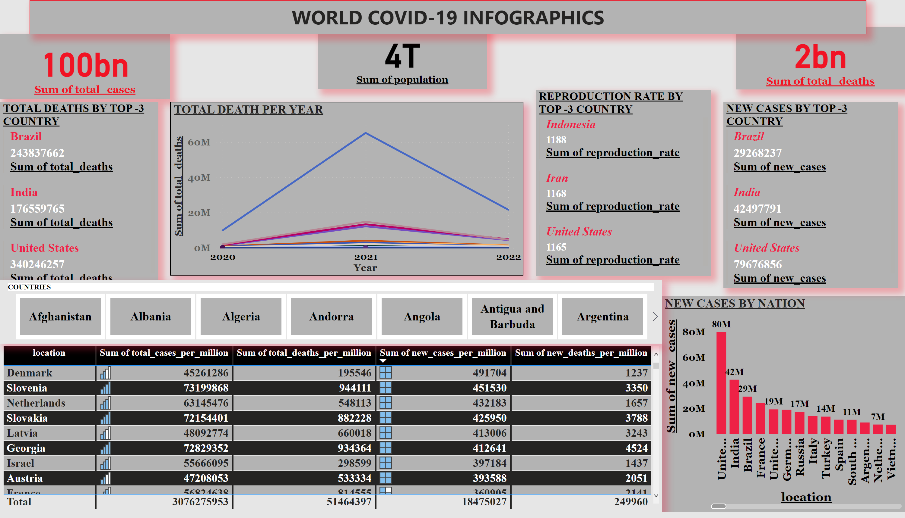
Page 1
Notes:
card
No alt text provided
card
No alt text provided
card
No alt text provided
NEW CASES BY NATION
No alt text provided
TOTAL DEATHS BY TOP -3 COUNTRY
No alt text provided
NEW CASES BY TOP -3 COUNTRY
No alt text provided
REPRODUCTION RATE BY TOP -3 COUNTRY
No alt text provided
tableEx
No alt text provided
textbox
No alt text provided
TOTAL DEATH PER YEAR
No alt text provided
slicer
No alt text provided

